Slide 1
git on the bandwagon
Jeff Grover
iQuHACK git tutorial
Jan 31, 2025

Slide 2
Outline
What even is git?
Setup and workflows
Tools and opinions
Demo time!

Slide 3

The status quo
├─ analysis_v0.ipynb
├─ analysis_v1.ipynb
├─ analysis_v1_final.ipynb
├─ analysis_v1_final_final.ipynb
├─ analysis_v2_final_final.ipynb

Slide 4

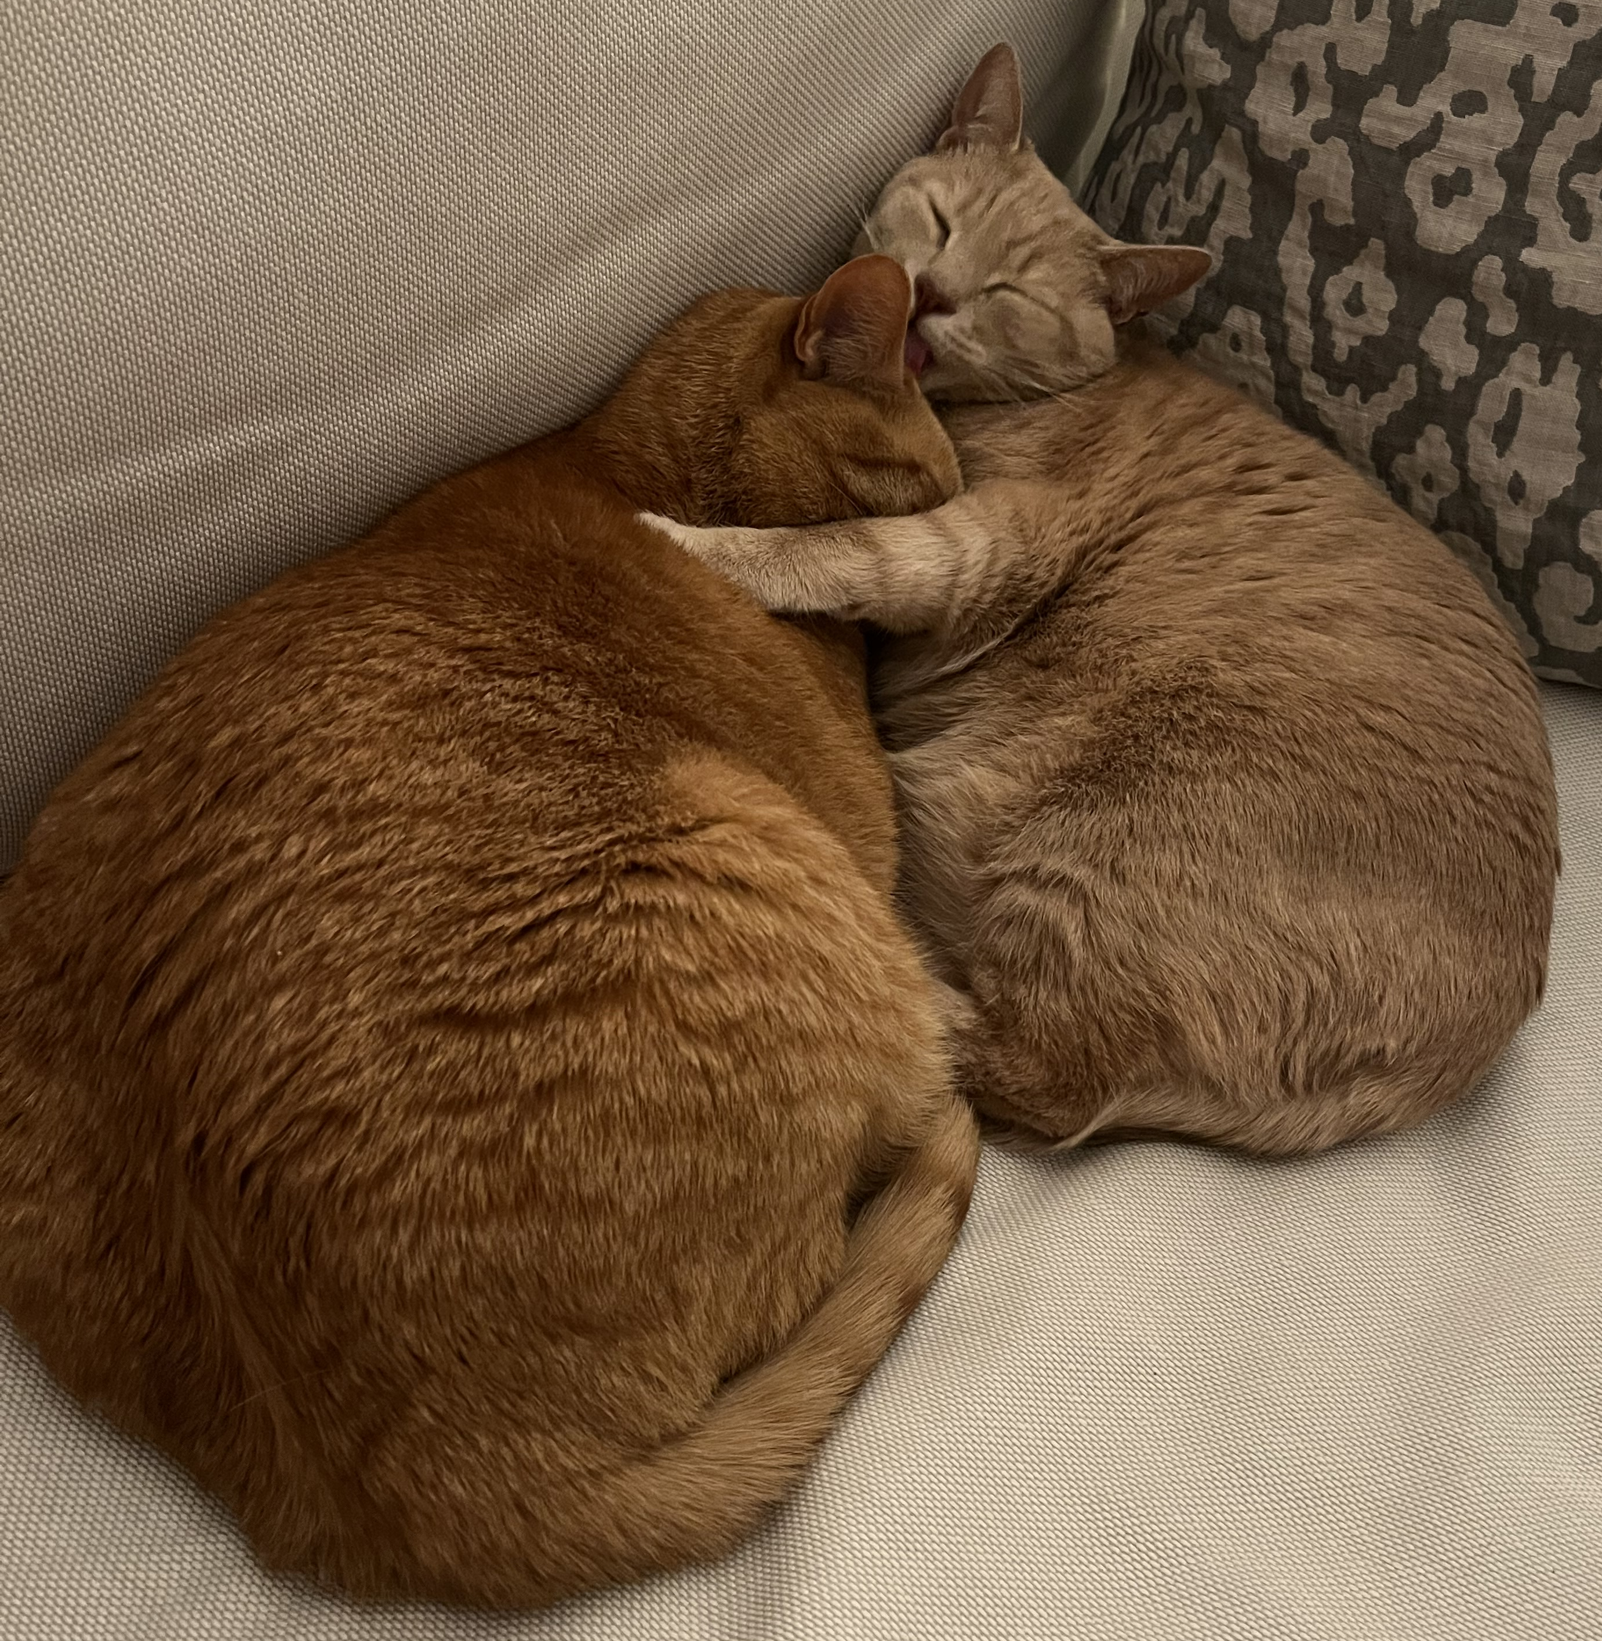
The status quo
├─ analysis_v0.ipynb
├─ analysis_v1.ipynb
├─ analysis_v1_final.ipynb
├─ analysis_v1_final_final.ipynb
├─ analysis_v2_final_final.ipynb
├─ analysis_v2_final_final_hugo_v0.ipynb
├─ analysis_v2_final_final_winston_FINAL.ipynb
├─ analysis_v2_final_final_hugo_v1_FINALFINAL.ipynb
We need a way to make coding with Hugo easier.

Slide 5

A solution: git
code + structure + local copies + collaboration =

Slide 6
What even is git?
git is a version control system with local+remote repositories, commits, and branches
secret place to hide
changes when you need to
switch branches
“staging” area:
add changes here
before committing
the collaborative repo,
usually on the cloud
(see next slide)
stash
workspace
index
local repo
remote repo
the directory and files
literally on your computer.
if you edit a file, you edit it here
local copy of repo,
contains diffs, branches,
and commits

Slide 7



What even isn’t git?
These are not, strictly speaking, git!
These are tools that enable “distributed” version control
Host your repos *~*on the cloud*~* for collaboration
Also have other useful features:
Issues
Milestones
Pull/Merge requests
Code review
Releases
CI/CD pipelines
Web pages

Slide 8
How git works, illustrated
$ git status
> On branch master
> Your branch is up to date with ‘origin/master’.
> Untracked files
analysis.py
> nothing added to commit but untracked files present
stash
workspace
index
local repo
remote repo
touch analysis.py

Slide 9
How git works, illustrated
$ git status
> On branch master
> Your branch is up to date with ‘origin/master’.
> Changes to be committed
new file: analysis.py
stash
workspace
index
local repo
remote repo
touch analysis.py
git add analysis.py

Slide 10
How git works, illustrated
$ git status
> On branch master
> Your branch is ahead of ‘origin/master’ by 1 commit.
> Nothing to commit, working tree clean
stash
workspace
index
local repo
remote repo
touch analysis.py
git add analysis.py
git commit

Slide 11
How git works, illustrated
stash
workspace
index
local repo
remote repo
touch analysis.py
git add analysis.py
git commit
git push

Slide 12
How git works, illustrated
🚨 Leon made
a dank update! 🚨
stash
workspace
index
local repo
remote repo
git pull
git merge
git fetch

Slide 13
Outline
What even is git?
Setup and workflows
Tools and opinions
Demo time!

Slide 14



Get git
You should be good, but if not
http://git-scm.com/download/mac
$ brew install git
Idk, but probably use apt-get or something?
http://git-scm.com/download/linux
# apt-get install git
Godspeed, but I prefer git BASH
https://gitforwindows.org/
$ which git
> path/to/git
I almost entirely use the command line on a Mac,
but I will mention some useful tools in the last section.

Slide 15
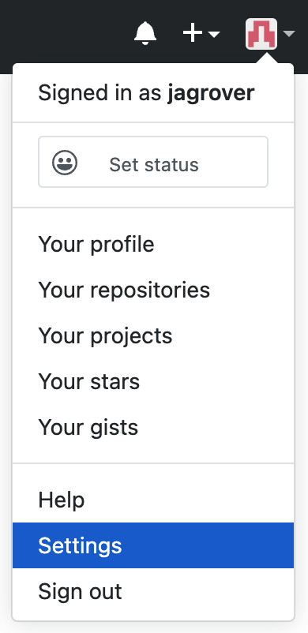
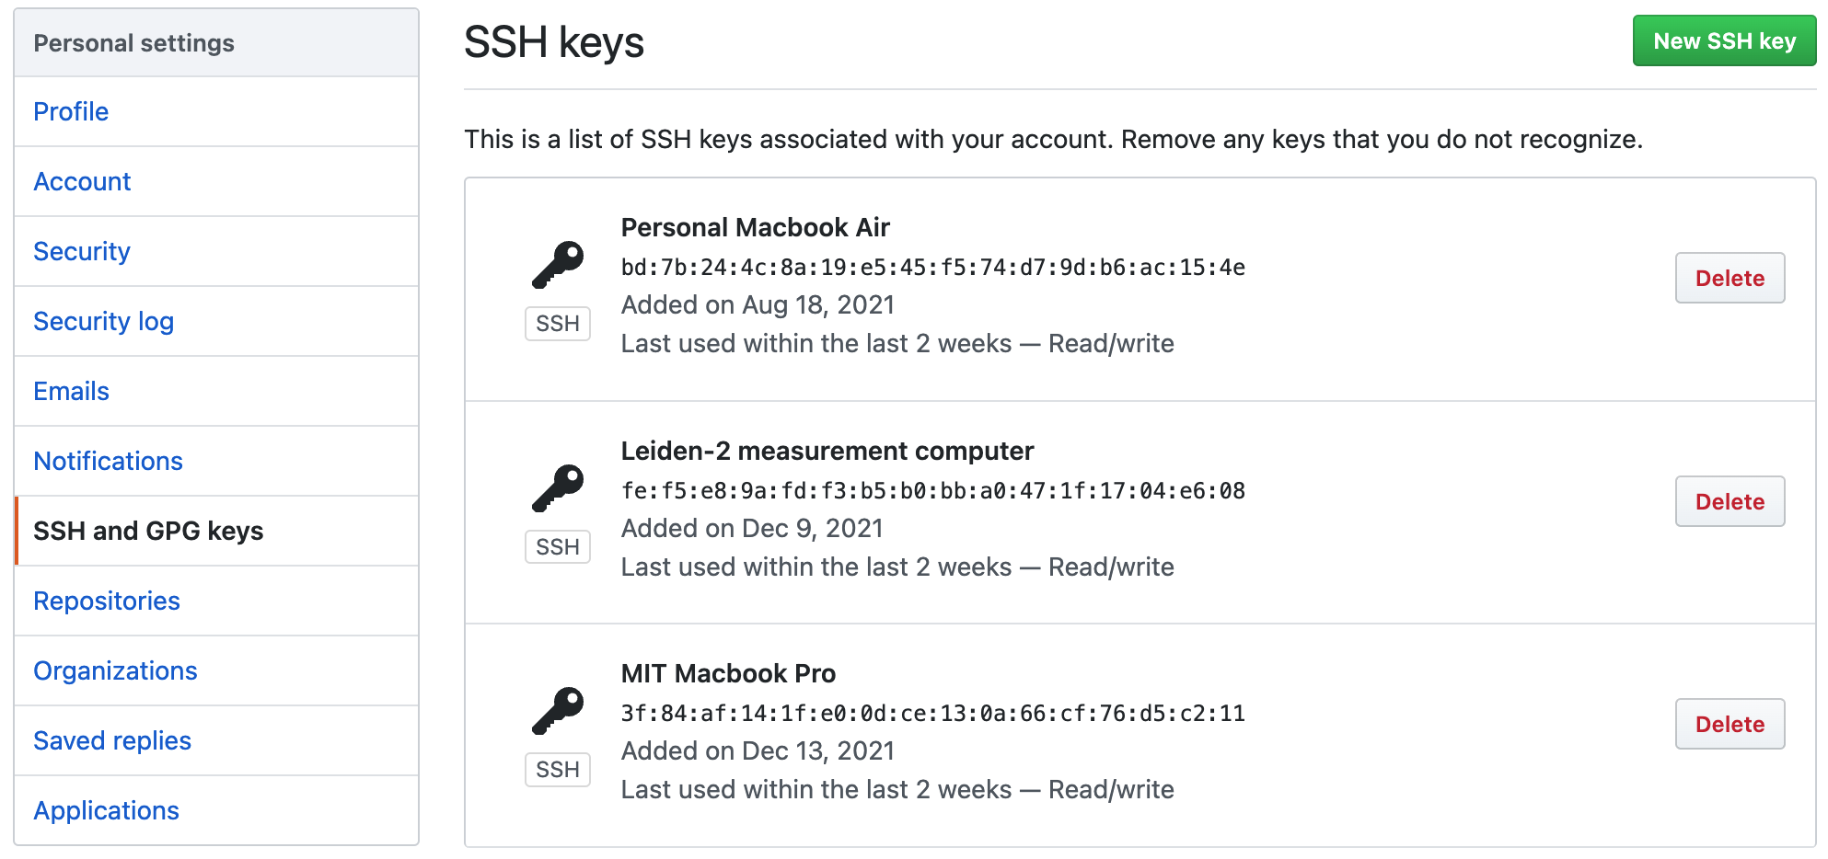
An aside: SSH keys
SSH key pairs are a much easier way of managing login credentials than passwords
Passphrases not required, but good practice
I generally make one pair per machine, but some make a pair per machine per service
Pick an algo;
RSA still standard
Make Shor work!
Optional: comment to disambiguate keys
$ ssh-keygen –t rsa –b 4096 -C “you@email.com” -f path/to/my_key
$ cat path/to/my_key.pub | pbcopy
# on windows, can do
$ clip < ~/.ssh/id_rsa.pub
Optional: change file path
(Default: ~/.ssh/id_rsa)

Slide 16
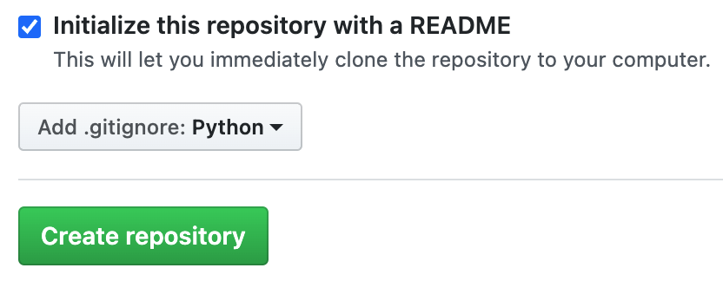
An aside: .gitignore
Nobody:
Absolutely no one:
Your repository:
Please please (please) create a .gitignore in your repository.
It tells git what to ignore (OHHHHH) when tracking changes.
GitHub even gives you a template if you make a new repo there:
.DS_Store
.ipynb_checkpoints/
__pycache__/
qpulse.egg-info/
.vscode/

Slide 17
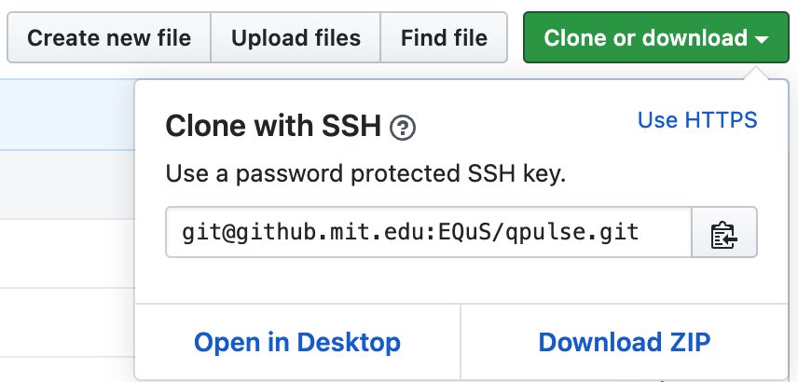
Clone
For now, let’s assume a repo (e.g. qpulse) exists, and you want to work on it
$ cd your/fave/code/dir
$ git clone git@github.mit.edu:EQuS/qpulse.git
# local repo now lives at your/fave/code/dir/qpulse

Slide 18
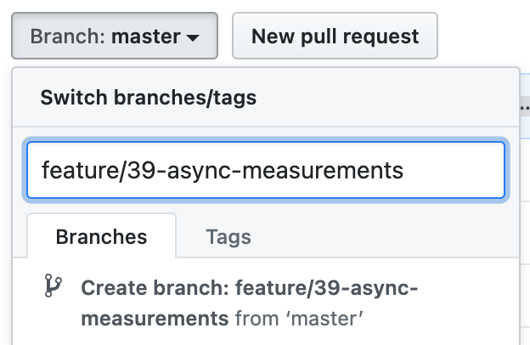
Make a branch (two ways)
Create branch on GitHub first
Create branch locally first
$ git checkout -b feature/39-async-measurements
$ git push –u origin feature/39-async-measurements
-u is short for –set-upstream
$ git pull
$ git checkout feature/39-async-measurements

Slide 19
Add and commit changes
NB: you can also “git rm” files
Yes:
No:
ProTip:
use git commit --amend
to add more changes to a commit (or update the message) before you push to remote!
$ git add dank_file_1.py dank_file_2.py dank_file_3.py
$ git commit –m “modules that perform dank analysis”
Do you remember all the files that might have been modified?
$ git add *
$ git commit
Messages are good for you (but more importantly, your collaborators)

Slide 20
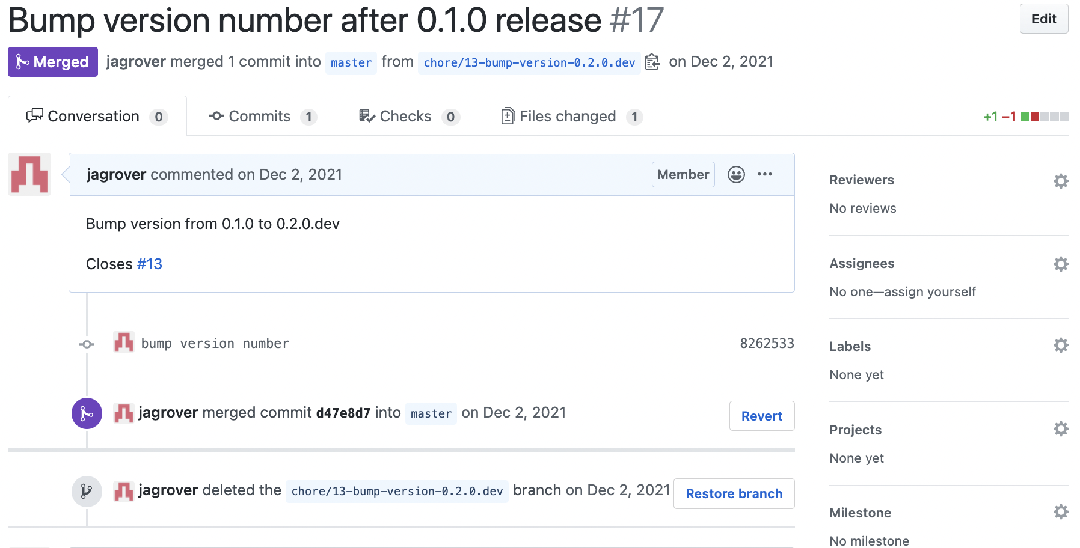


Open a Pull Request
Review is good!
Neat: auto-close issue when merged

Slide 21
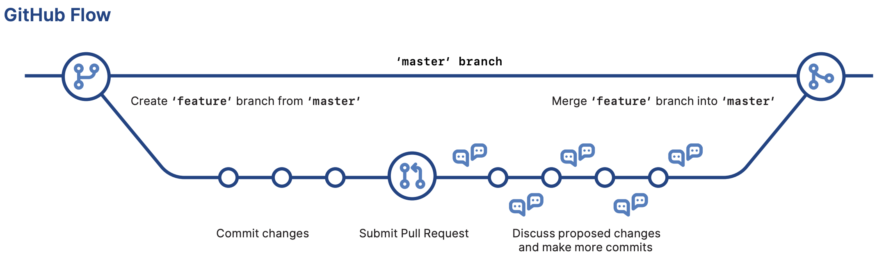
A git workflow, bird’s eye view
https://training.github.com/downloads/github-git-cheat-sheet.pdf

Slide 22
Outline
What even is git?
Setup and workflows
Tools and opinions
Demo time!

Slide 23
Some Opinions™
Protect the main branch on critical repos: can’t push to main/master
Commit often, with informational messages
Push before you leave
kind of like saving and closing a doc on Dropbox before going home
Keep Pull Requests small in scope
Start Pull Requests early if you want feedback!
Be nice in code review! (seriously.)

Slide 24

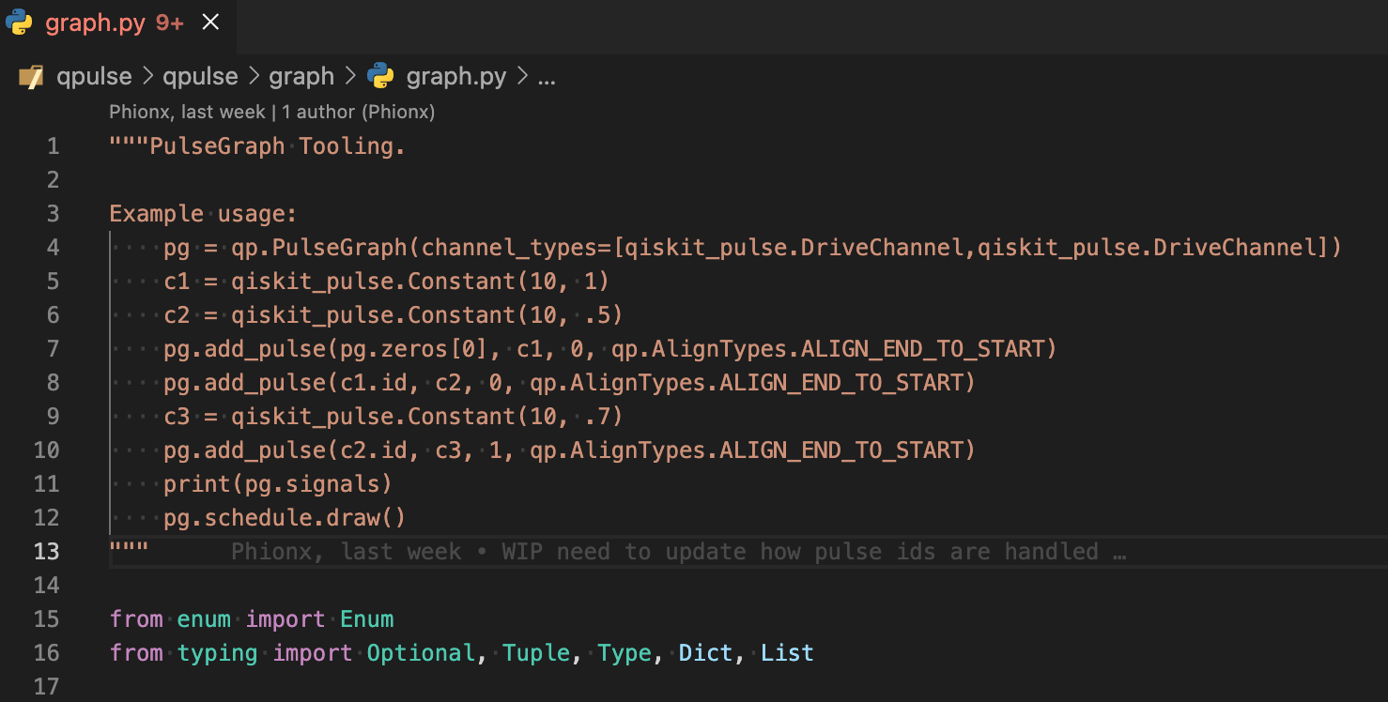
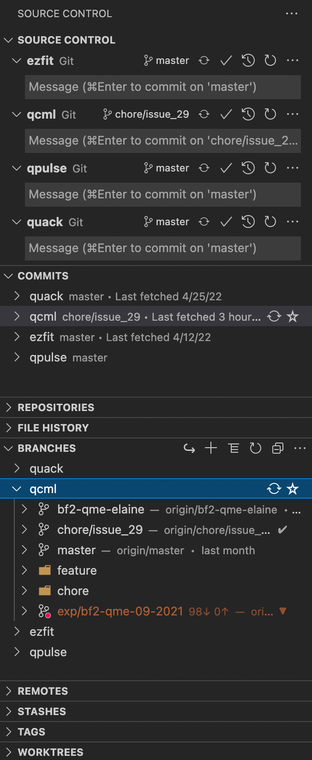
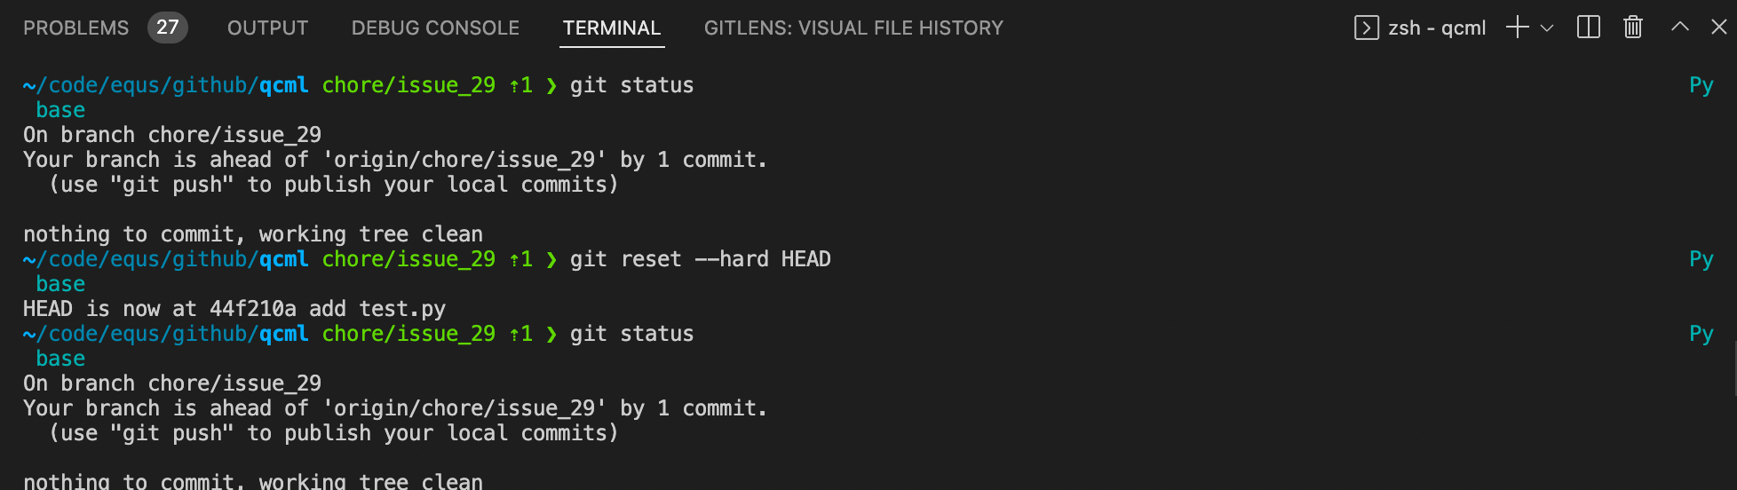
Useful tool: VSCode
Seamless git integration
(MSFT owns VSCode and, now, GitHub)
Extensions like GitLens show you who made what changes when…in-line!
And you’ve still got your terminal if you’re a luddite like me

Slide 25
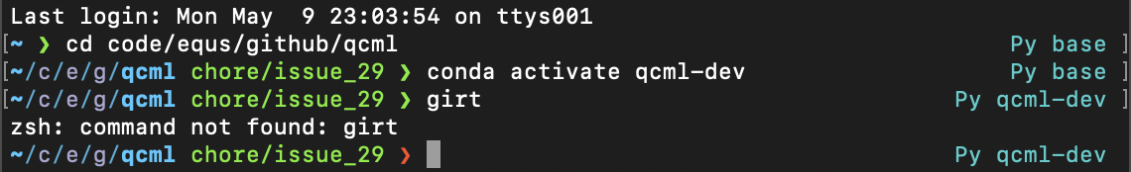
Useful tool (Mac): Oh My Zsh
Easy(-ish) way to configure zsh and terminal display
https://ohmyz.sh/
short path
git branch
failed command
conda env

Slide 26
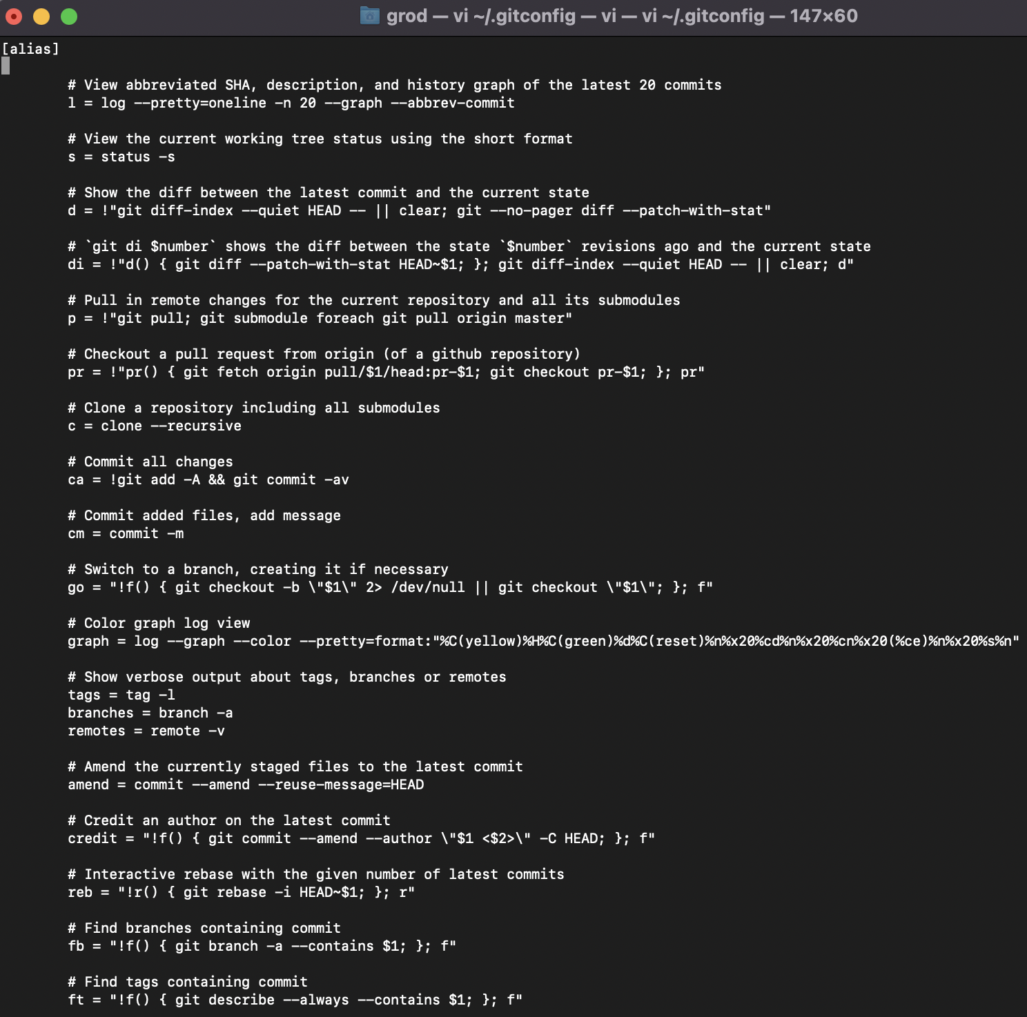
Useful tool: aliases in .gitconfig
e.g.: git s == git status

Slide 27
Other tips! (from Shantanu)
Writing code:
Uniform Formatting (would recommend the Black formatter)
Typing (e.g. def func(a: int))
Docstrings
Linters such as Black, flake8 (mypy for type checking)
Tests (unittest, pytest)
GitHub Desktop: a GUI for managing commits, branches, etc. (I have no idea how to use it)
Miniconda: package manager and virtual environment provider
Pros: virtual-env + pip
Auto-generate wiki from docstrings (e.g. yaleqc.com/qtcodes) Tutorial by Amir Ebrahimi: github.com/yaleqc/qtcodes/pull/80
or use ReadTheDocs Sphinx docs.readthedocs.io/en/stable/intro/getting-started-with-sphinx.html
Don’t hesitate to publish your package on PyPI! betterscientificsoftware.github.io/python-for-hpc/tutorials/python-pypi-packaging

Slide 28
Helpful resources (that I stole from)
Visual git cheatsheet (truly incredible)
https://ndpsoftware.com/git-cheatsheet.html#loc=index
GitHub training cheatsheets
https://training.github.com/
Fixing a git mess, workflow edition
http://justinhileman.info/article/git-pretty/git-pretty.png
Visualizing git branches and collaboration in various scenarios (long presentation)
http://www.cs.cmu.edu/~539/notes/notes-visualizing-git-workflows.pdf
STACKOVERFLOW (duh)

Slide 29
Outline
What even is git?
Setup and workflows
Tools and opinions
Demo time!

Slide 30
Demo!
Make sure you have git
Make sure you have a GitHub account (and SSH/GPG/other functioning credentials)
Fork https://github.com/iQuHACK/2025-git-tutorial
Clone your fork locally
Add your name to the README
Commit the changes
Push the changes
Open a Pull Request to incorporate them with the main repo

Slide 31
Backup/Other Stuff

Slide 32
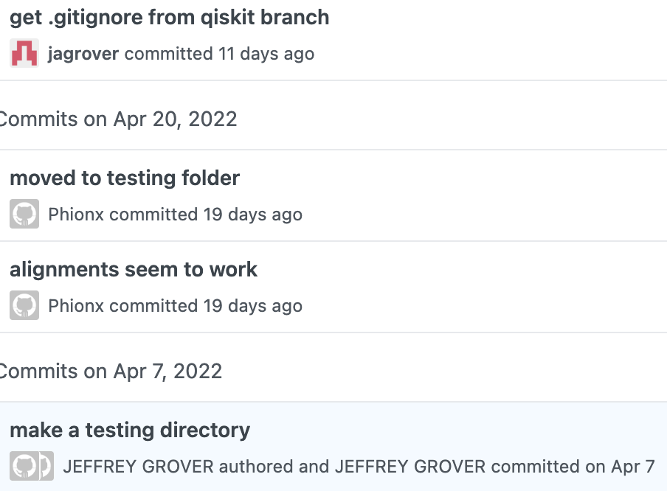
Update .gitconfig
Who is JEFFREY GROVER?
Oh, it was jagrover!
Update info for this repo only
Update info for all repos on computer
$ git config user.name “Jeffrey Grover”
$ git config user.email “jagrover@mit.edu”
$ git config --global user.name “Jeffrey Grover”
$ git config --global user.email “jagrover@mit.edu”
Let global config reflect the computer’s primary development account
Notes:
Other ways: aliases, ~/.ssh/config

Slide 33
How to: checkout one (1) file from another branch
Leon just made a dank change on his feature branch: wyd?
# do this from the branch you’re working in
$ git checkout feature/1-leon-dankness dank_analysis.py
Leon’s branch
Leon’s code

Slide 34
How to: stash and pop
You realize you’re on the wrong branch, and you just wrote some amazing code: wyd?
stash
workspace
index
local repo
remote repo
git stash
main
git switch new-branch
new-branch
git stash pop

Slide 35
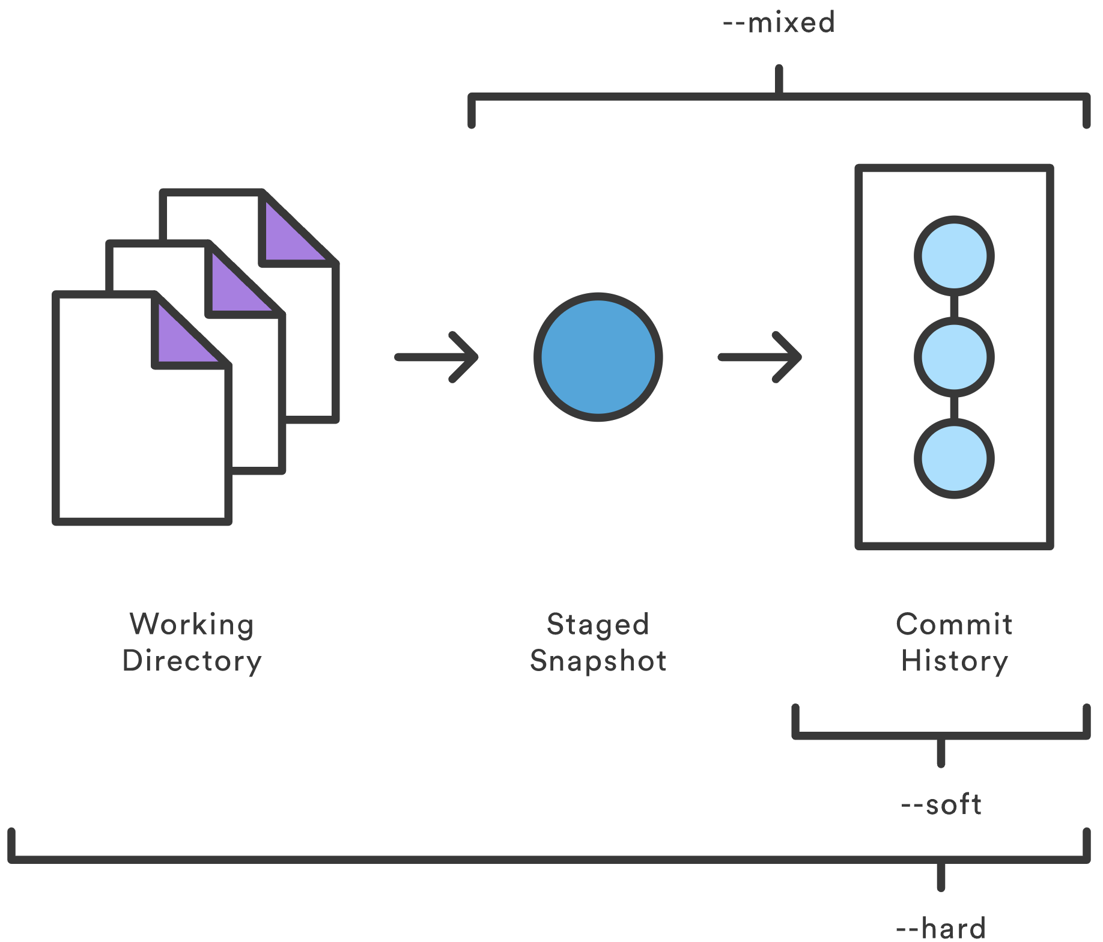
Wait, jk! Undo a commit!
$ git reset --mixed HEAD~1
HEAD is the current commit
“~1” means go one commit back
--soft: lightest touch
--mixed: Goldilocks zone (default)
--hard: know what you are doing!
If you pushed your commit to GitHub, do NOT git reset it!
Talk to me (and I’ll look at StackOverflow).
https://www.atlassian.com/git/tutorials/undoing-changes/git-reset
https://devconnected.com/how-to-git-reset-to-head/

Slide 36
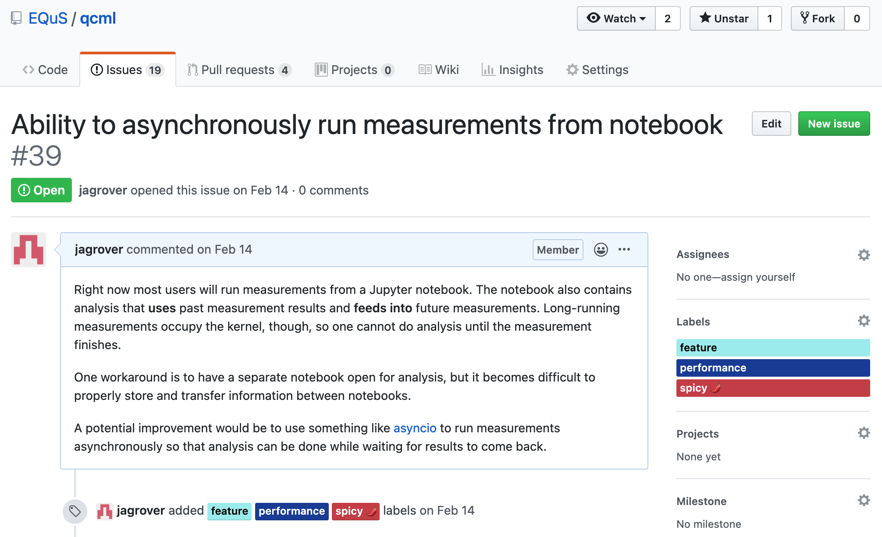
Make an issue
Issues are good for
planning!
not duplicating work!
the historical record!
documenting what’s broken!

Slide 37
Types of branches (personal conventions)
Feature
For adding new features to the codebase
Usually track issues
feature/<#>-<short-description>
Chore
For doing chores – documentation, refactoring, The Lord’s Work
Usually track issues
chore/<#>-<short-description>
Bugfix
For fixing bugs (OHHHHHHH) in the codebase
Usually track issues
bugfix/<#>-<short-description>

